Slide 1
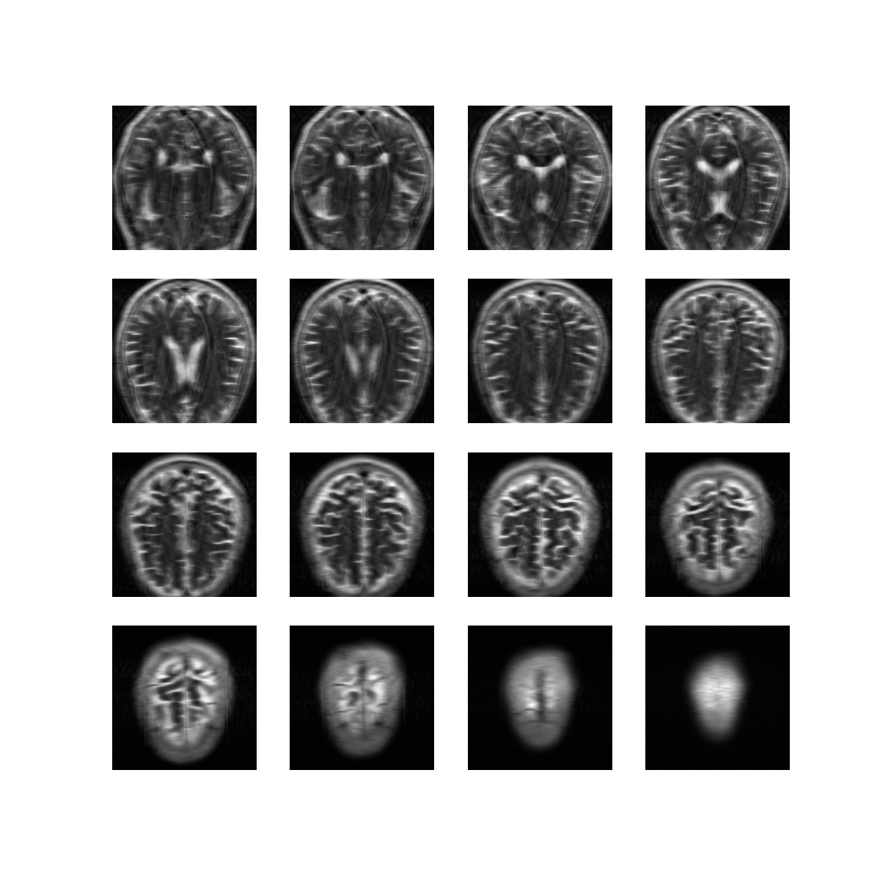

Deep MRI
Compression
ELEN E68976 Hi-D Data Analysis
Presented May 9, 2022
Alex Thornton
Dept. of Electrical Eng.
Columbia University
New York, NY
apt2141@columbia.edu

Slide 2
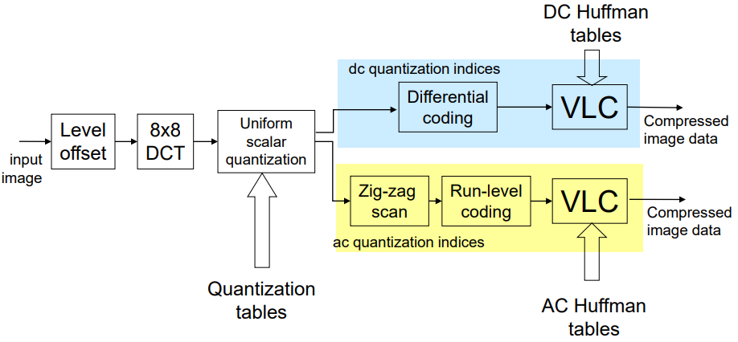
Project Overview
JPEG compression is optimized for general images
But what about images that share common features?
Maybe we want translation between image and embedding to be lossless
This project explores using wavelet features and deep learning models for MRI compression use cases
Fig 1. JPEG compression [1]

Slide 3


Dataset
Approved use of FastMRI dataset from Facebook (Meta) and NYU [2]
Only using subset of the multicoil_test dataset ~34.2GB zipped
1 brain for test (16 slices), 26 brains for evaluation (14 - 16 slices each)
Open source software suite for slicing and manipulating data

Slide 4
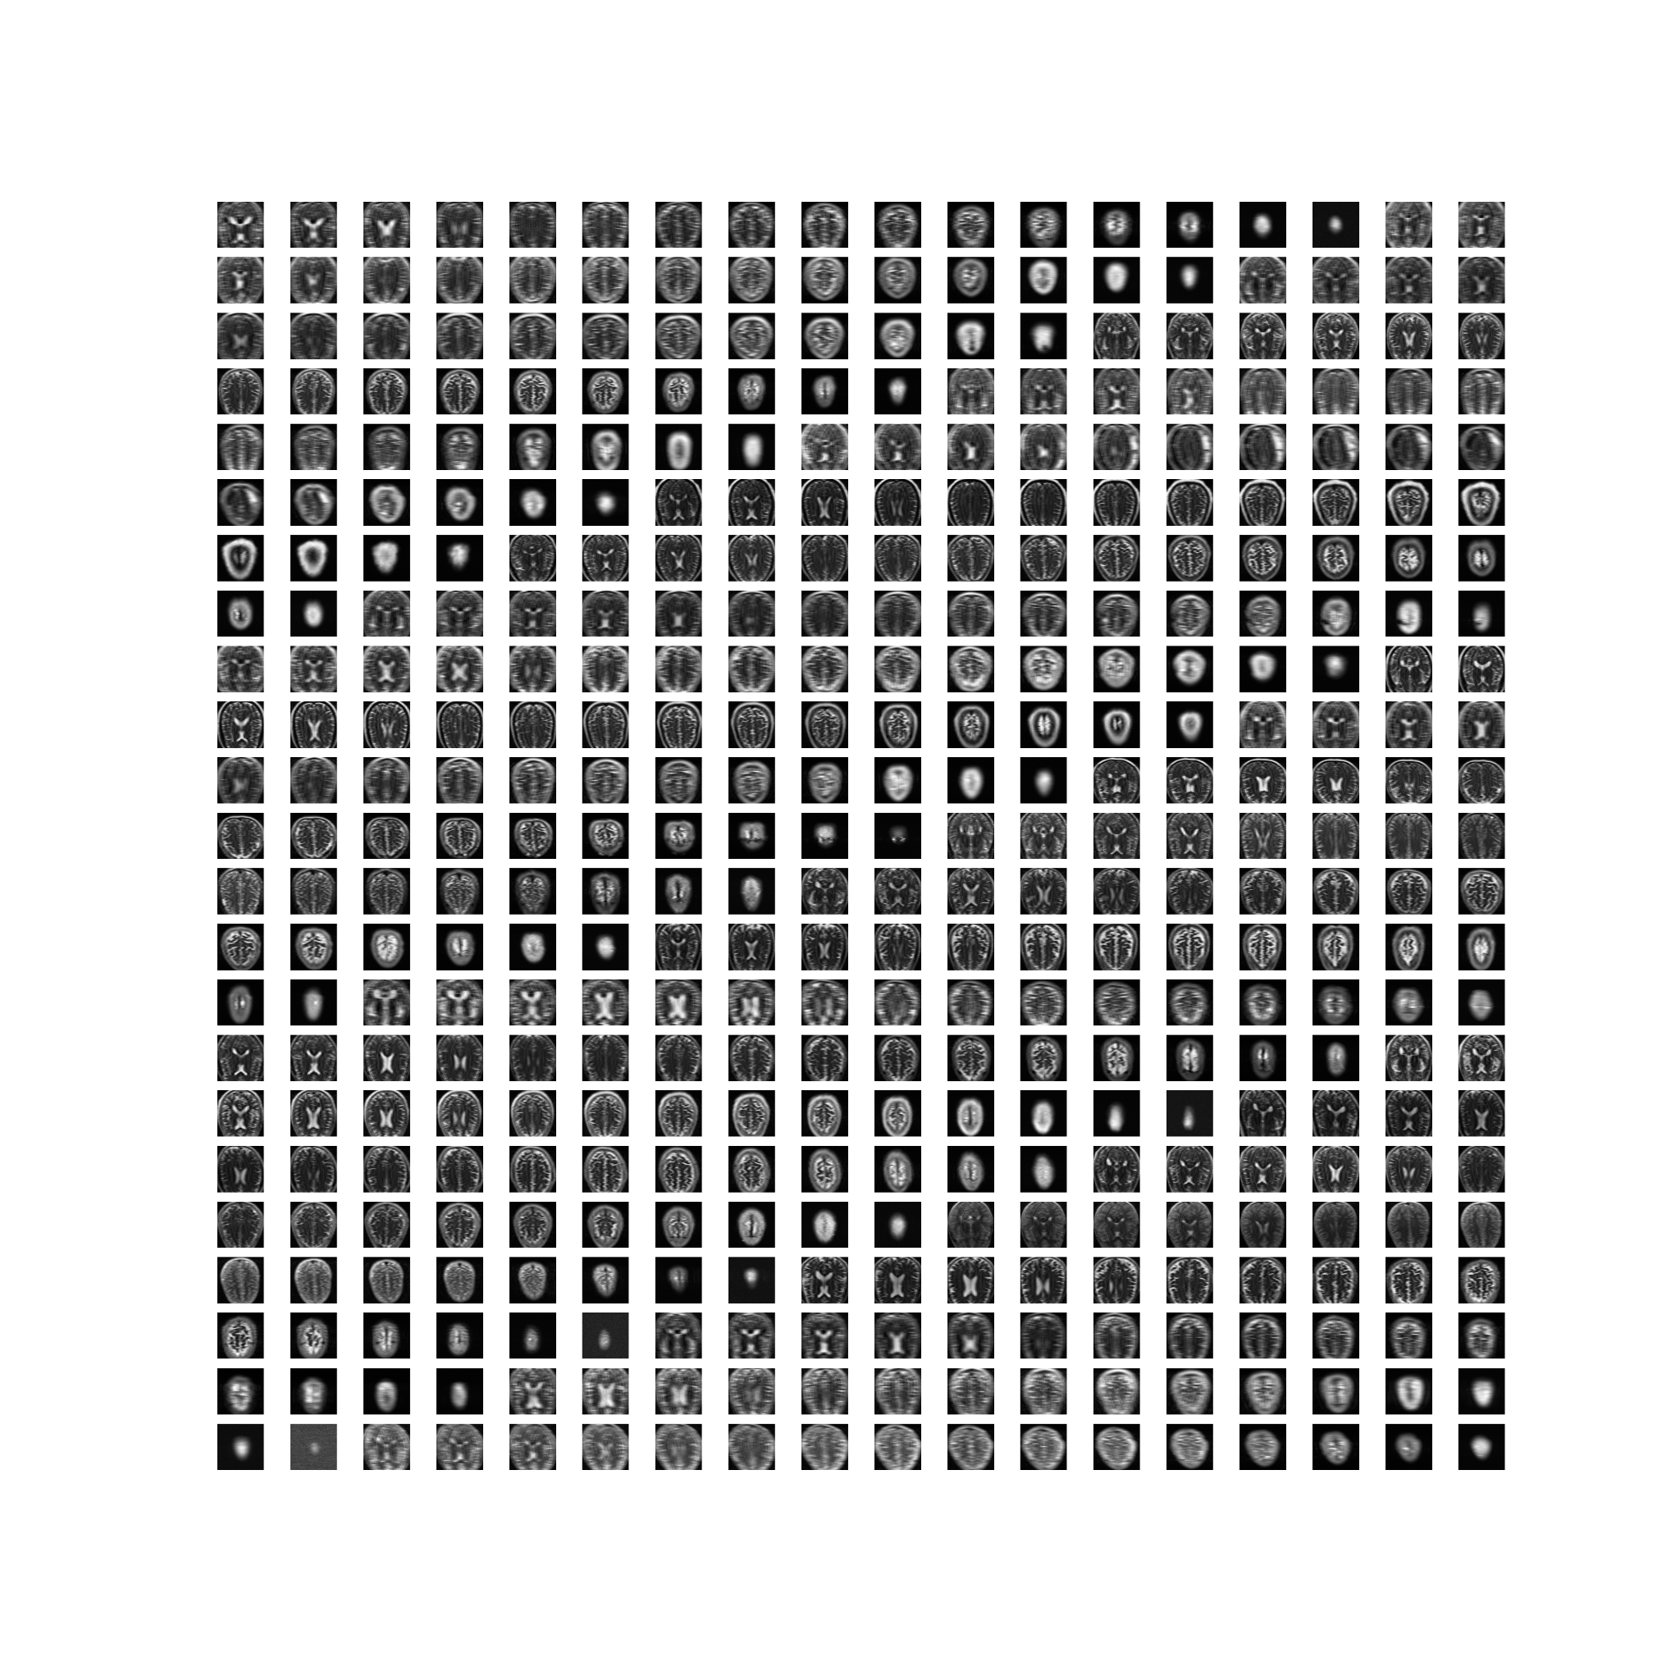
Fig 2. Full Training Set

Slide 5
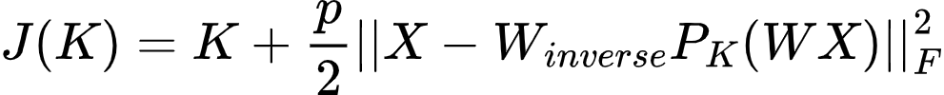
K- Wavelet Reconstruction
Compress & reconstruct with k wavelet coefficients (like in HW)
Cost function is trade off between k and squared error of pipeline
Cannot relax k → L1 norm, k must be integer
Eq 1. K-Wavelet cost function

Slide 6
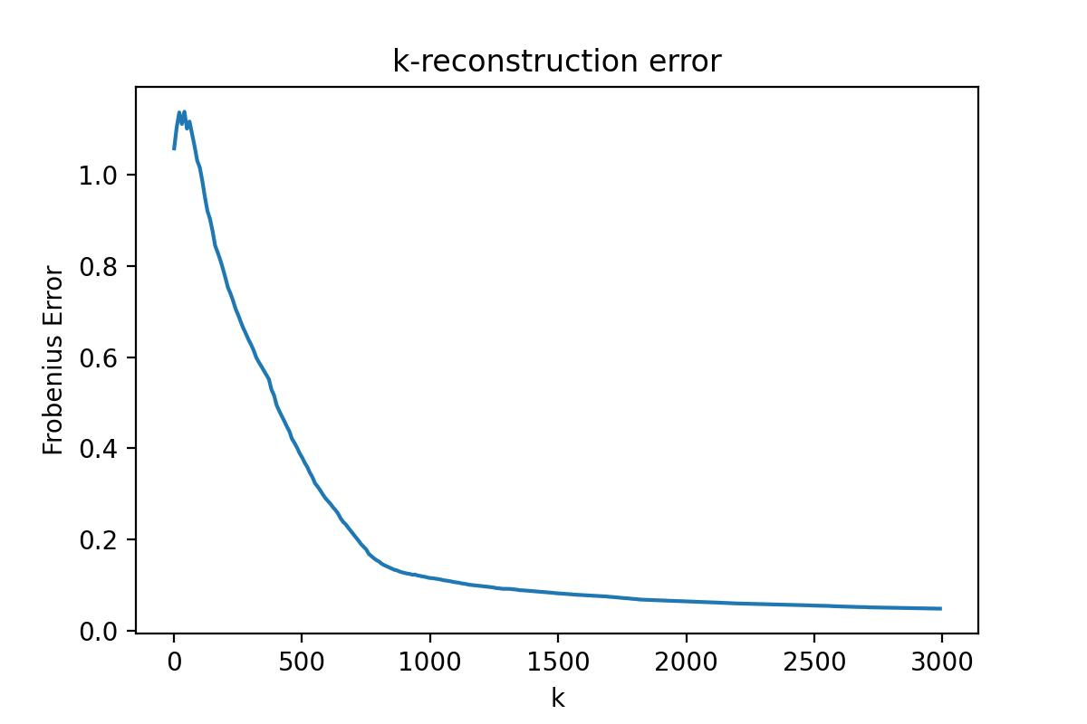
K-Wavelet Loss
Compute reconstructed error at all k, average over all test slices
Trade-off captured in plot, choose appropriate p in loss equation
K=2896 has average error of ~5%, upper bound at K=3000
Fig 3. Sparsity-error trade-off

Slide 7
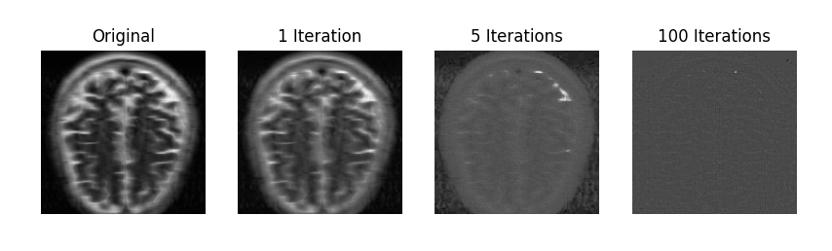
Use Case 1: Generational Loss
Recursive JPEG compressions quickly erodes quality (photocopier effect)
First iteration alone introduces ~26% error (Frobenius norm)
Fig 4. Recursive JPEG compression

Slide 8
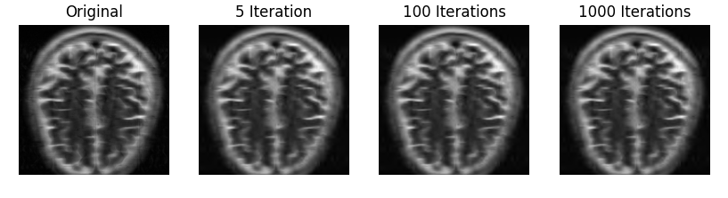
K-Wavelet Generational Loss
K-wavelet compression is resilient to recursive operations
Important features are constant, low error after many iterations
Fig 5. Recursive k-wavelet reconstruction (K=3000)

Slide 9
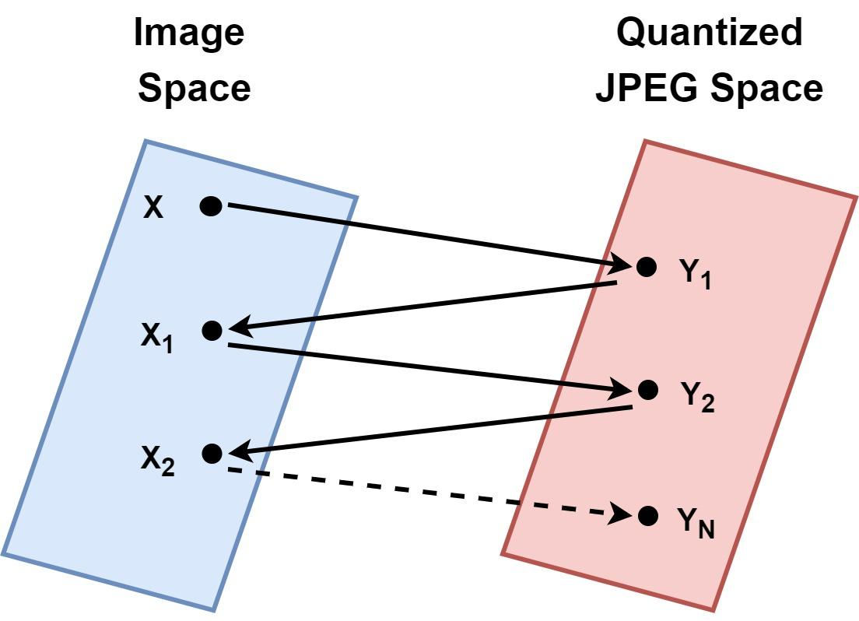
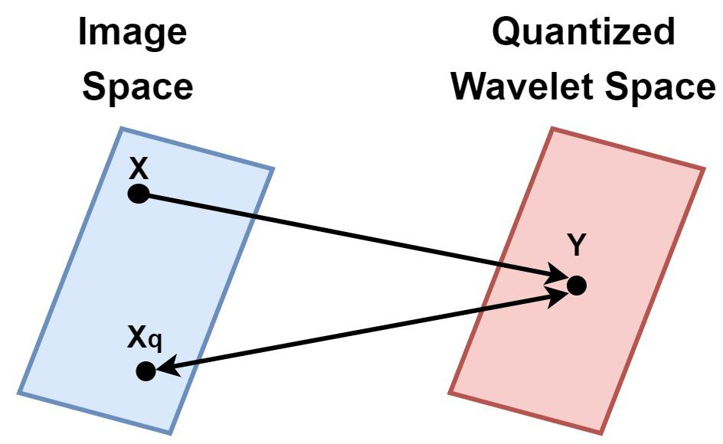
Fixing Generational Loss
Fig 6. JPEG generational loss
Fig 7. Quantized k-wavelet generational loss

Slide 10
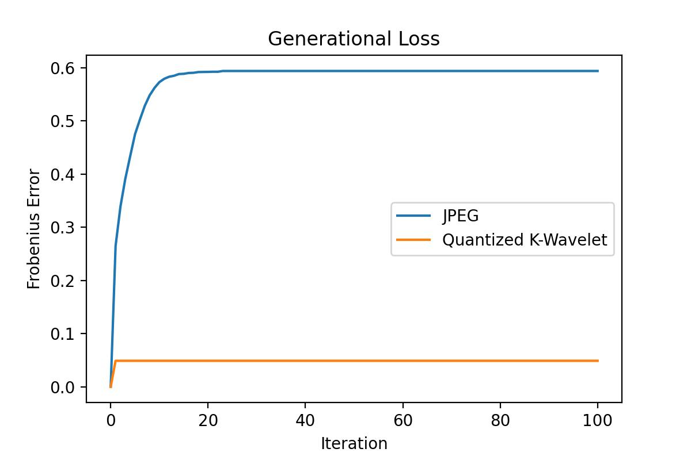
Fixing Generation Loss
Only ~4% loss in first iteration, then none!
Note: Even JPEG2000 (wavelet based) isn't immune, quantized every iteration
Fig 8. JPEG vs Quantized K-Wavelet

Slide 11
Why do we care?
But how much space?
If you can recover quantized image from embedding and vice versa, you only need to have one!
If you need many images uncompressed at once, could just delete the embeddings and recover later
Can't just save wavelet coefficients, need locations in 256x256 map
3000 coefficients * ( (float32 quantization) + (log2(256) + log2(256)))
14.4 KB to store! But do we really need those indices?

Slide 12
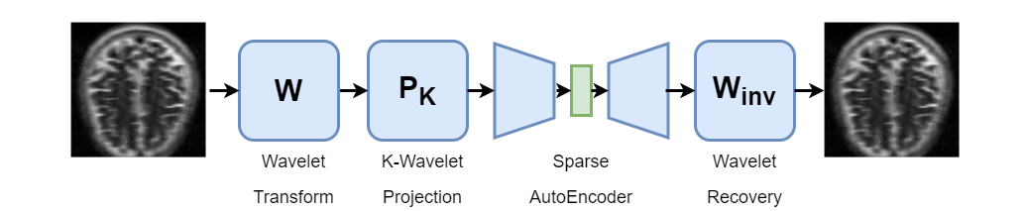
Use Case 2: Can We Go Smaller?
If we will only compress once, generational loss doesn't matter
What if we only had to store the values themselves, save some space?
Wavelet features and neural network architecture hybrid may work
Fig 9. Proposed Hybrid wavelet - deep learning model

Slide 13
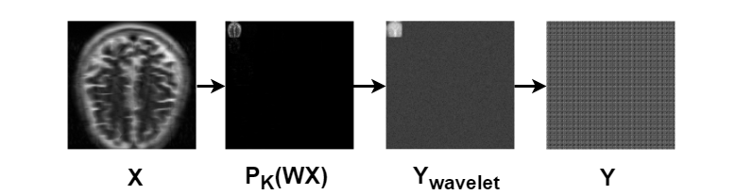
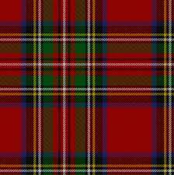
Naive Approach: Shallow FFNN AutoEncoder
Consider a simple feed-forward neural network
Linear(256*256) → 3000 Latent Layer → Linear(256*256)
Was able to somewhat capture wavelets, but failed on image recovery
Fig 10. FFNN reconstruction failure

Slide 14
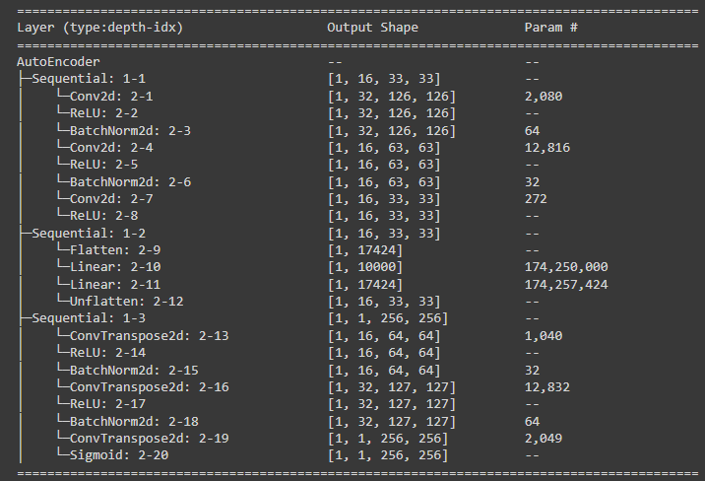
Improved Solution: CNN AutoEncoder
PyTorch sequential model
Epochs: 250
Batch size: 207
Learning rate: 0.5
Encode: (1,256,256) →(16,32,32)
Latent: (16,32,32) → (K) → (16,32,32)
Decode: (1,256,256) → (16,32,32)
Fig 11. CNN Layers

Slide 15
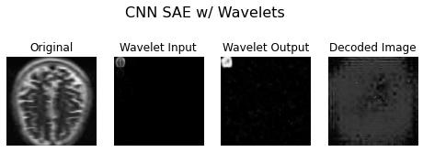
SAE with Wavelets
Fig 12. CNN reconstruction

Slide 16
Back to basics
Maybe the wavelet features for a SAE was a bad idea
What about just passing the regular images through?
Fig 13. Proposed Hybrid wavelet - deep learning model

Slide 17
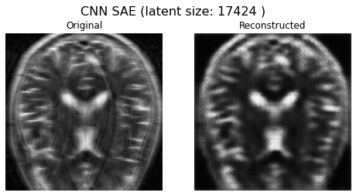
How Low Can We Go?
Required Memory
1089*32 = 69.7 KB
K = 16*33*33

Slide 18
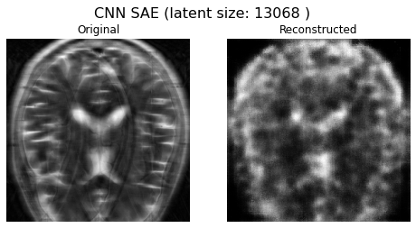
How Low Can We Go?
Required Memory
1089*32 = 52.3 KB
K = 12*33*33

Slide 19
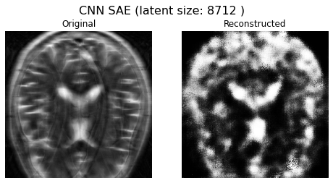
How Low Can We Go?
Required Memory
1089*32 = 34.8 KB
K = 8*33*33

Slide 20
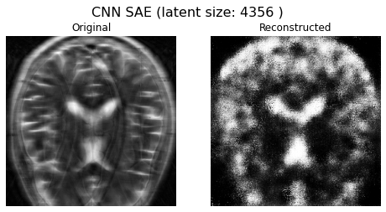
How Low Can We Go?
Required Memory
1089*32 = 17.4 KB
K = 4*33*33

Slide 21
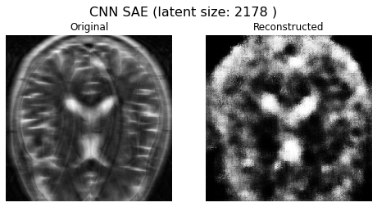
How Low Can We Go?
Required Memory
1089*32 = 8.712 KB
K = 2*33*33

Slide 22
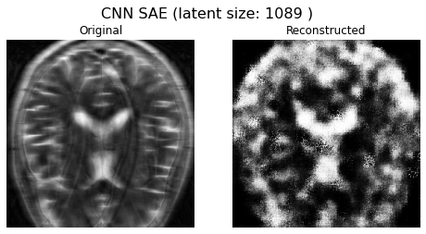
How Low Can We Go?
Required Memory
1089*32 = 4.356 KB
K = 1*33*33

Slide 23
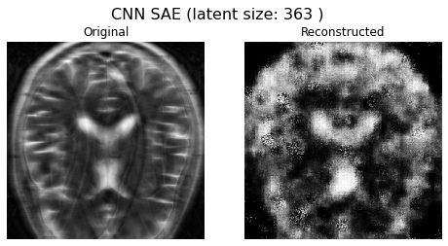
How Low Can We Go?
Required Memory
363*32 = 1.448 KB
K = 11*33

Slide 24
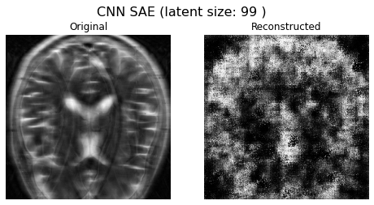
How Low Can We Go?
Required Memory
363*32 = 0.396 KB
K = 3*33

Slide 25
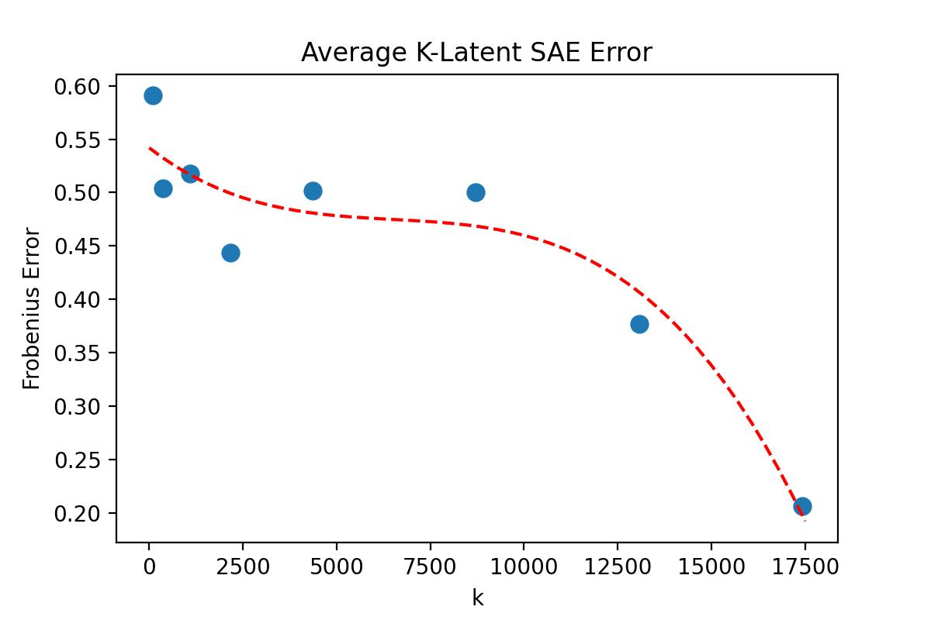
Conclusion
CNN SAE can capture features at very small sizes (extremely lossy quality)
Quantized K-Wavelet recovery isn't too big (14.4KB) and has the best recovery error, plus generational loss immunity!
Different use cases require different models, but Quantized K-Wavelet probably wins for most application
Fig 14. SAE error decreasing latent shape

Slide 26
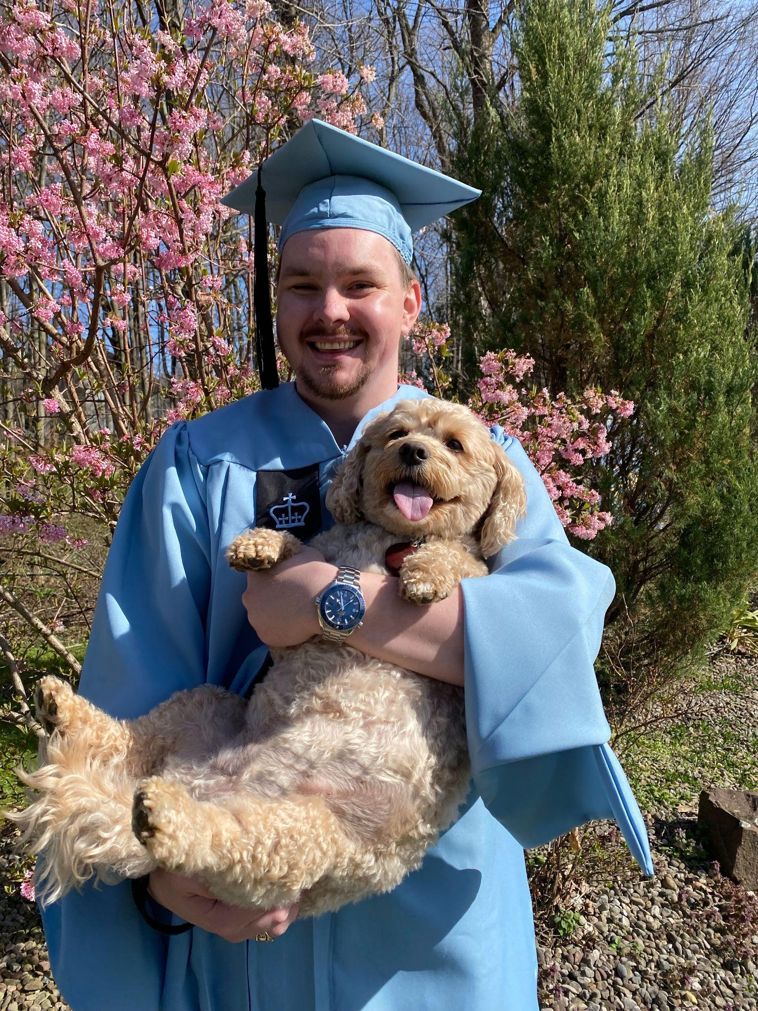
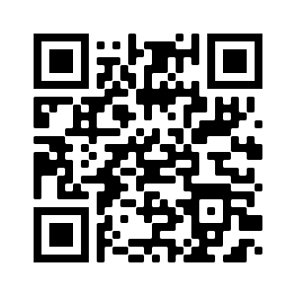
Check it out on github!
https://github.com/athornton1618/MRI_Compression
This presentation completes my Master of Science degree requirements. Thank you Columbia!

Slide 27
References
[1] B. Girod, “JPEG Standard.” http://web.stanford.edu/class/ee398a/ handouts/lectures/08-JPEG.pdf. [Online; accessed 01-May-2022].
[2] F. Knoll, J. Zbontar, A. Sriram, M. J. Muckley, M. Bruno, A. Defazio, M. Parente, K. J. Geras, J. Katsnelson, H. Chandarana, Z. Zhang, M. Drozdzalv, A. Romero, M. Rabbat, P. Vincent, J. Pinkerton, D. Wang, N. Yakubova, E. Owens, C. L. Zitnick, M. P. Recht, D. K. Sodickson, and Y. W. Lui, “fastmri: A publicly available raw k-space and dicom dataset of knee images for accelerated mr image reconstruction using machine learning,” Radiology: Artificial Intelligence, vol. 2, no. 1, p. e190007, 2020. PMID: 32076662.
[3] “Paul Lauterbur and Sir Peter Mansfield for MRI: In our series Focusing on Nobel Prize winners that have contributed to cardiovascular medicine, Mark Nicholls looks at the work of two scientists recognized for their discoveries concerning magnetic resonance imaging (MRI),” European Heart Journal, vol. 40, pp. 1898–1899, 06 2019.
[4] J. Wright and Y. Ma, High-Dimensional Data Analysis with Low- Dimensional Models: Principles, Computation, and Applications. Cambridge University Press, 2022.
[5] J. Sneyers, “Why JPEG is like a photocopier.” https://cloudinary.com/ blog/why jpeg is like a photocopier. [Online; accessed 03-May-2022].
[6] V. Corona, Y. Dar, G. Williams, and C.-B. Sch¨onlieb, “Regularized compression of mri data: Modular optimization of joint reconstruction and coding,” 2020.
[7] B. Girod, “JPEG2000 Standard.” http://web.stanford.edu/class/ee398a/ handouts/lectures/10-JPEG2000.pdf. [Online; accessed 07-May-2022].

